Slide 1



UNIT 2
Lesson 8
IN &OUT OF FASHION
Part 2

Slide 2
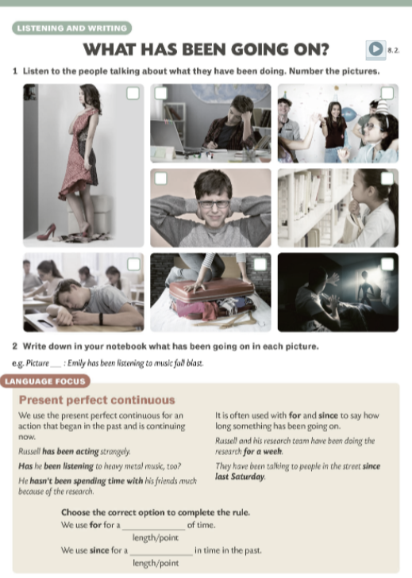
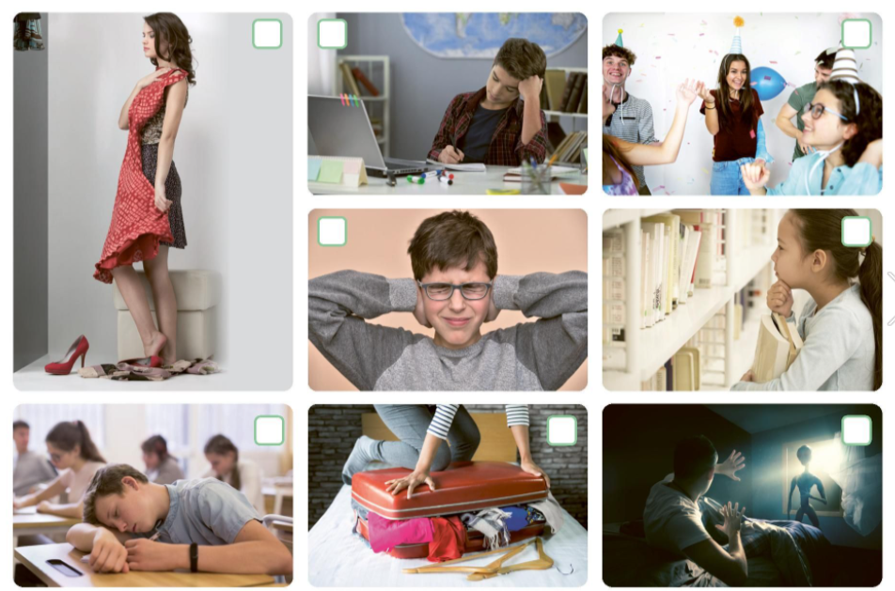

1
5
3
4
2
7
6
8

Slide 3
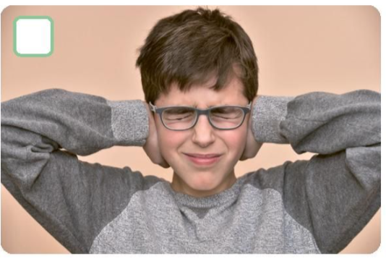
What’s going on? Emily is listening to music at full blast.
What’s the problem? Emily started doing this an hour ago. She is still listening to the music.
It’s annoying.
Emily’s brother is angry and he says: ‘Emily has been listening to music at full blast.’
This sentence tells us what is going on and that it has been going on for some time.

Slide 4


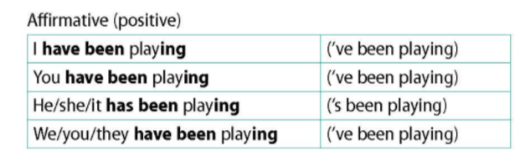
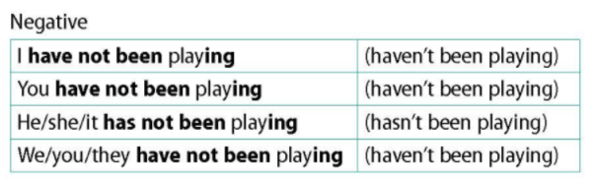
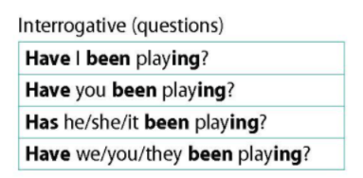

Slide 5
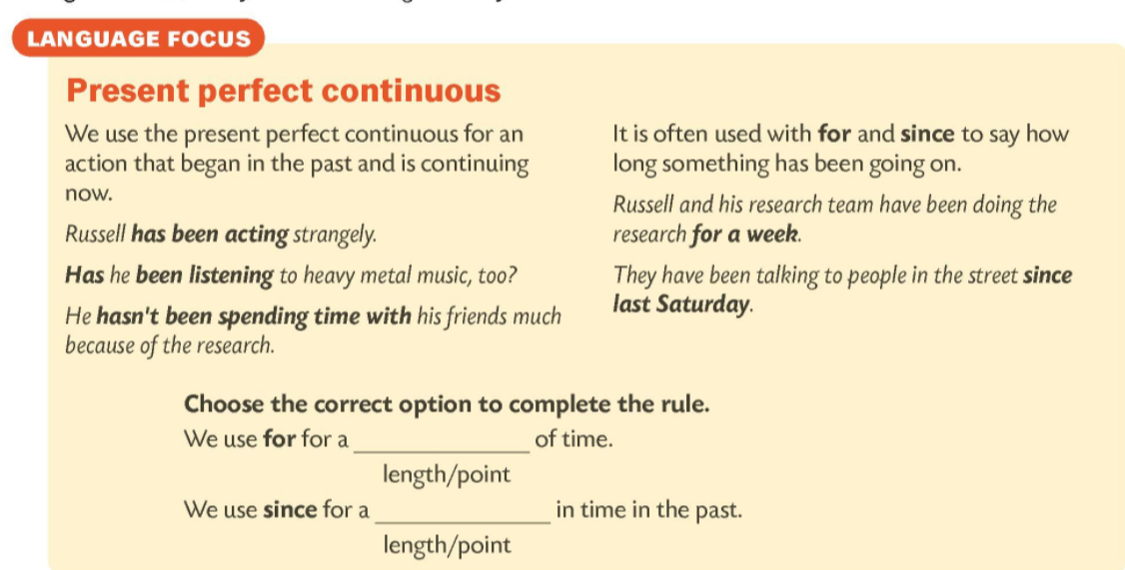
length
point

Slide 6
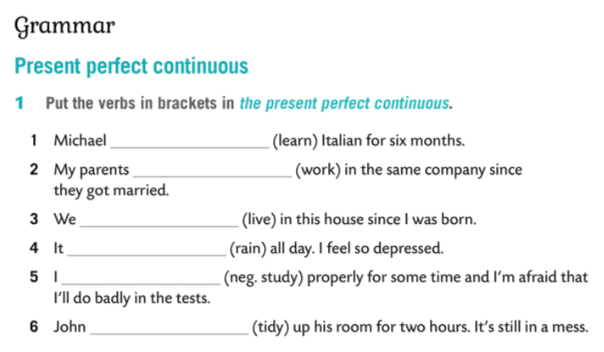

has been learning
have been working
have been living
has been raining
haven’t been studying
has been tidying

